Slide 1
Achieving an autonomous corporatized EBSWC through Governance and Organizational development By Babatope Babalobi, Institutional Development Specialist, SUWASA End of Project Workshop, 30th April, 2015, International Conference Center, Abakaliki

Slide 2
Outline
Situation before SUWASA’s intervention
SUWASA’s objective
Activities
Results achieved
Challenges
Lessons learnt
Recommendations for Way forward

Slide 3
Situation before SUWASA’s intervention
The corporation did not have a Board of Directors, though it was statutorily required to have one by the Ebonyi State Water Corporation law 2004 (now know as Ebonyi State Water Corporation Law Cap 82, Vol. 03)
EBSWC did not have organizational and administrative manuals. There was a lack of effective organizational structure, job descriptions, defined standardized operational processes, low staff capacity, loose internal control processes, essentially indicating that the EBSWC did not run as a corporatized organization.
Importantly, there was absence of clearly defined work schedule for each cadre of staff in the corporation leading to assignment of jobs on ad hoc basis etc.

Slide 4
SUWASA’s objective
Support the transformation of EBSWC into an autonomous and financially viable utility leading to appointment of EBSWC BoD, development of Performance contract(s), enhanced capacity for EBSWC staff, and generally improved governance of EBWSC.

Slide 5
Activities
Sustained Advocacy on the State Executive to appoint BOD for the EBSWC in line with the extant law. Courtesy visits/letters by SUWASA Regional office and USAID Nigeria mission
Appointment of Consultant to conduct Organizational development study of the EBSWC through a participatory process.
Capacity building trainings

Slide 6
Results achieved
BOD of the EBSWC inaugurated by the Ebonyi State government
Appointment of the EBSWC, in Acting Capacity for nine years, confirmed by the State Governor
EBSWC signed a Code of Conduct and adopted a Board Charter to guide its operations.
BOD approved implementation of OD design
EBSWC organizational development report containing EBSWC Restructuring (Staff Placement and Organizational Structure); Human Resource Development Strategy; Compensation Plan; Job Description/Profile;Training Plan;Administrative Manual; and Performance Guidelines

Slide 7
Results achieved
5 (five) Departments, 20 (twenty) key Units, and 5 (five) Auxiliary Units all reporting the Managing Director (directly or indirectly).
All the 161 existing staff were placed in positions in line with their job qualifications and experiences as well as the human resources needs of the EBSWC.
Staff job schedule has been printed out and circulated so staff can be apprised of their new roles and responsibilities.
Fifty one (51) training programs cutting across all the departments of the corporation was developed

Slide 8
Results achieved
The report contains a compensation plan that makes the Corporation competitively attractive is produced.
A 13 level career progression for the EBSWC staff to replace the existing 17 level progression developed.
The following Performance management templates were developed:Performance Management between the State Government and EBSWC ; and Performance Contract Template between EBSWC and the Zonal Offices; and Individual Performance Contract Template

Slide 9
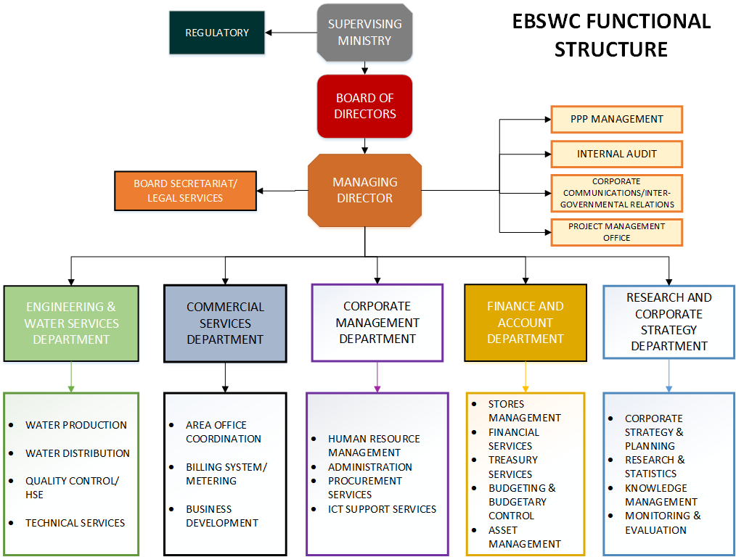

Slide 10
Challenges
Low production/water revenues of the EBSWC hinder the immediate implementation of the compensation plan.
EBSWC, in practice not answerable to the Board as he is appointed by the State Governor.
Appointment of Board is political and they may be sacked by the new administration

Slide 11
Mr. Obasi Emmanuel talking about improved staff productivity through SUWASA’s intervention

Slide 12
Lessons learnt
Sustained advocacy by USAID Nigeria/SUWASA paid off with the Governor succumbing to pressure to appoint the BOD.

Slide 13
Recommendations for Way forward
EBSWC management working with the BOD, office of the Head of Service, and Civil Service Commission to implement OD recommendations over the next five years

Slide 14
Presentation of the OD report to the Ebonyi State Head of Service Chief (Mrs) Ugo Nnachi by SUWASA Team Leader, Adedayo Mark-Adeyemi

Slide 15
Presentation of the OD report to the Ebonyi State Chairman, Civil Service Commission Chief Harisson Onwe by SUWASA Team Leader, Adedayo Mark-Adeyemi

Slide 16
Thank you
Notes:
Notes ...................

